Slide 1
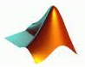







DIGITAL COMMUNICATIONS
Course Code: 23EC2208A
Dr. G V Subbarao
Department of Electronics and Communications Engineering
K L E F Deemed to be University

Slide 2
SYLLABUS
(Content Prepared by Dr. M. Venugopala Rao, CC)
Pulse Modulation Techniques: Baseband signals. Sampling process; Concepts on PAM, PWM and PPM. Quantization Process; Quantization Noise; Linear and Non-linear PCM codes, Noise Considerations in PCM Systems; PCM Line Speed, DPCM, Delta Modulation (DM) and Adaptive DM. Line codes.
Transmission Through Bandlimited Channels: Line Coding; Characterization of Band limited Channels, Optimum Receiver for the AWGN Channel, Detection of Baseband Signals in Noise, Matched filter, Other binary signal transmission and antipodal signals., The Power Spectrum of a Digital PAM Signal, Inter symbol Interference: Eye diagrams, System Design for Band limited Channels. Raised Cosine spectrum, Linear and non-linear Equalizers.
Digital Transmission via Carrier Modulation: Concepts on measure of Information: Bits, Bit Rate, Baud, and M-ary Encoding; Noiseless coding-Huffman coding, Channel capacity, ASK, PSK, FSK, QAM. Bandwidth Efficiency, Carrier and Clock Recovery, Probability of Error and Bit Error Rate, Error Performance.
Spread Spectrum Modulation: Pseudo-noise sequences, notion of spread spectrum, Direct Sequence Spread Spectrum (DSSS) with coherent BPSK, Signal space, dimensionality and processing gain, Probability error and Frequency-Hop Spread Spectrum.

Slide 3
Discrete / Digital / M-ary Pulse Amplitude Modulation
(Content Prepared by Dr. M. Venugopala Rao, CC)

Slide 4
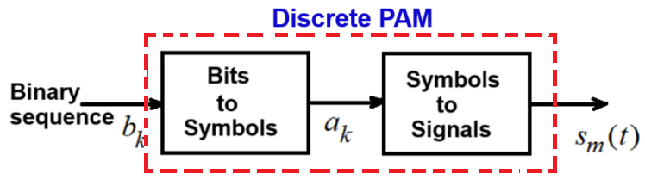

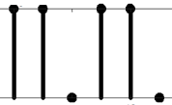
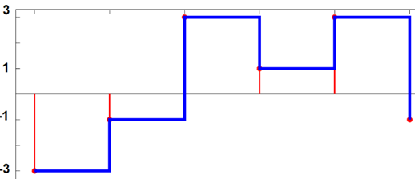
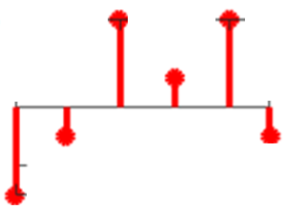

Discrete / Digital / M-ary Pulse Amplitude Modulation
Digital Pulse Amplitude Modulation (PAM) is a digital modulation scheme in which the amplitude, duration, or position of the transmitted pulses varied in a discrete manner in accordance with the given data stream.
Here we are interested in amplitude variations of given data stream.

Slide 5
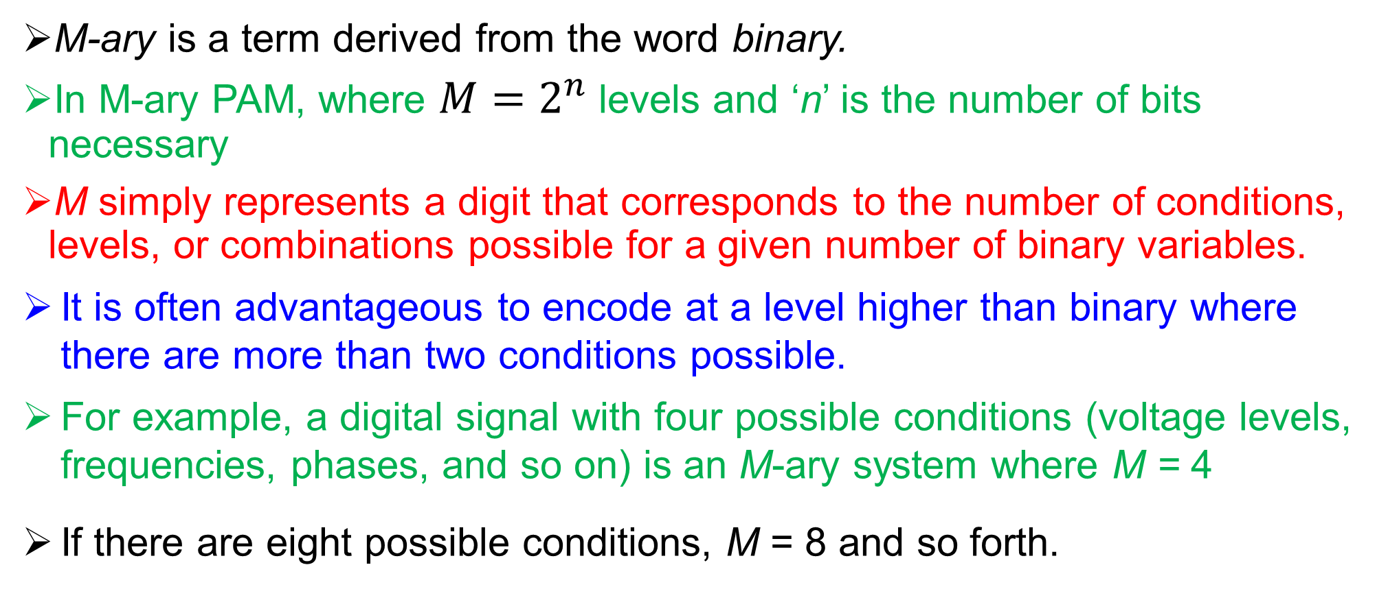
Representation of Digitally Modulated signals: M-ary PAM
M-ary is a term derived from the word binary.
In M-ary PAM, where $M=2^{n}$ levels and ‘n’ is the number of bits necessary
M simply represents a digit that corresponds to the number of conditions, levels, or combinations possible for a given number of binary variables.
It is often advantageous to encode at a level higher than binary where there are more than two conditions possible.
For example, a digital signal with four possible conditions (voltage levels, frequencies, phases, and so on) is an M-ary system where M = 4
If there are eight possible conditions, M = 8 and so forth.

Slide 6
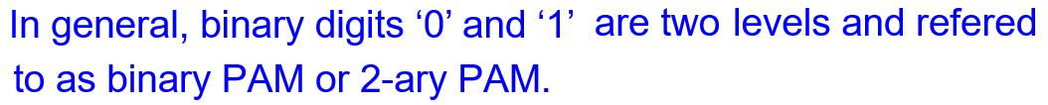
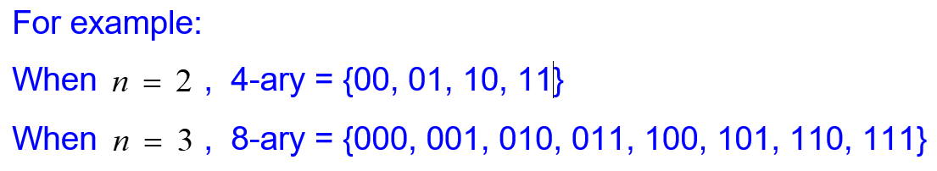

Slide 7
Bits to Symbols Mapping
The binary representation 0 and 1 is not usually very convenient from the point of view of efficient and reliable data transmission.
The solution is to recode the binary sequence 0,1 into say for example binary ±1.
This can be accomplished using either the linear operation 2x − 1 (which maps 0 into −1, and 1 into 1),
or −2x + 1 (which maps 0 into 1, and 1 into −1).
This ‘binary’ ±1 is an example of a two-element symbol set.

Slide 8
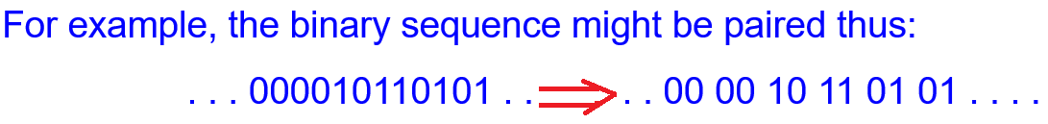
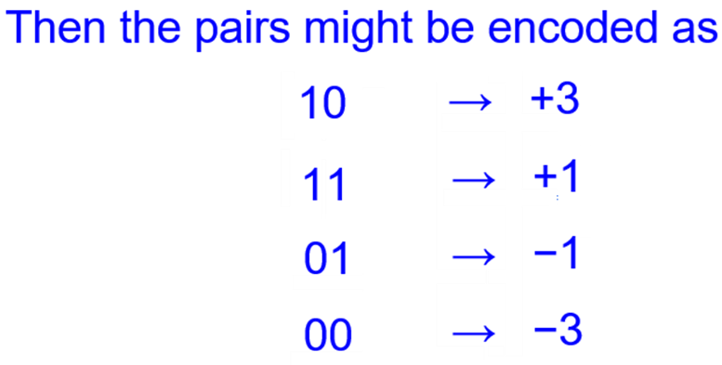
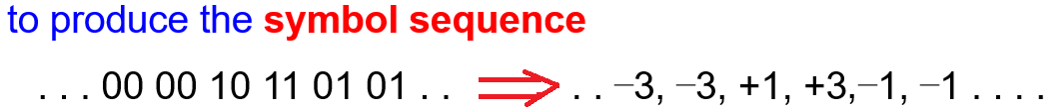
There are many other common symbol sets.
In multilevel signalling, the binary terms are gathered into groups. For instance, recodes the information into a four-level (Gray code) signal or alphabet..
For M=2, the set is {-1, +1}
For M=4, the set is {-3, -1, +1, +3}
For M=8, the set is
{-7, -5, -3, -1, +1, +3, +5, +7}

Slide 9


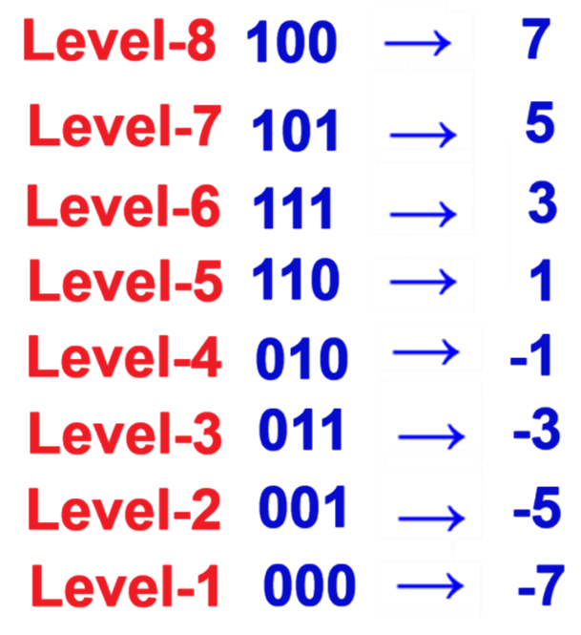
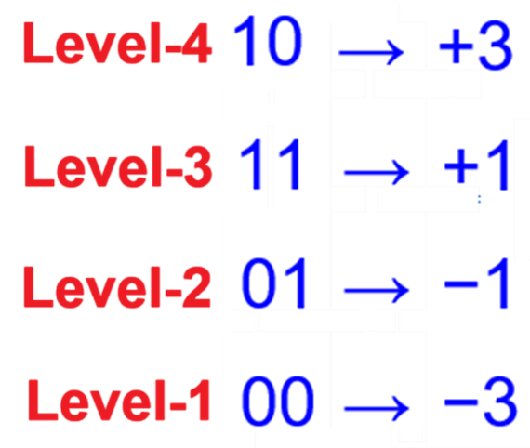

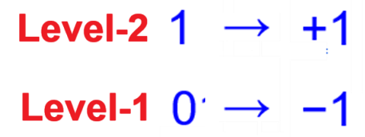
Bits to Symbols Mapping
n = 1-bit, M = 2 levels
n = 2-bit, M = 4 levels
n = 3-bit, M = 8 levels
Symbol sequence = 2 x -1,
where x = data sequence

Slide 10
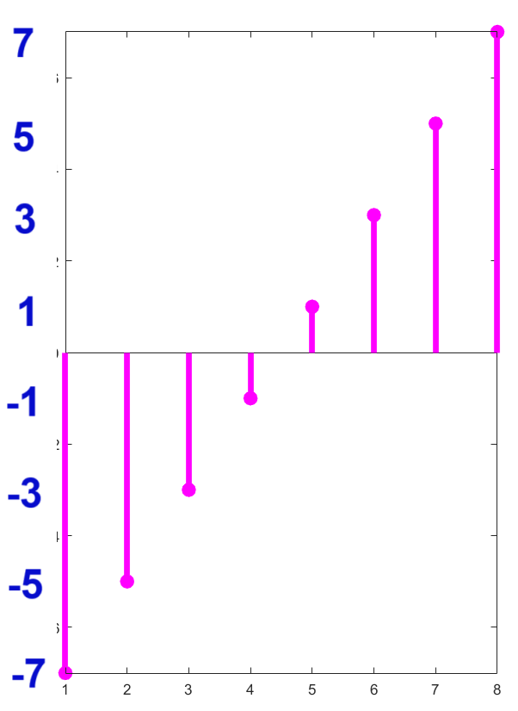
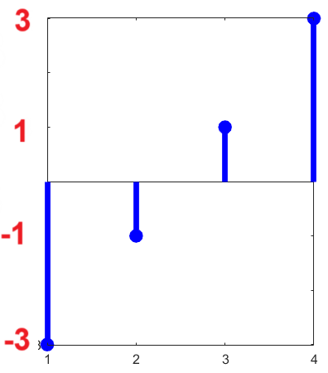
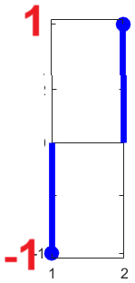
n = 3-bit, M = 8 levels
n = 2-bit, M = 4 levels
n = 1-bit,
M = 2 levels

Slide 11
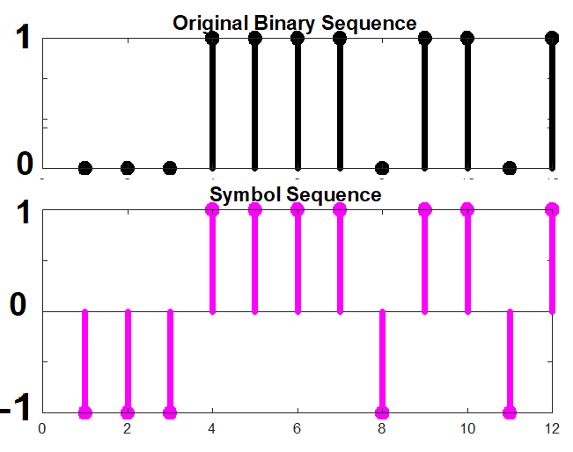
Ex1: Mapping a binary sequence (bits) [0 0 0 1 1 1 1 0 1 1 0 1] to a symbol sequence for M = 2
Answer: Symbol sequence = 2 x -1, where x = data sequence
data sequence = [0 0 0 1 1 1 1 0 1 1 0 1 ];
symbol sequence = [-1 -1 -1 1 1 1 1 1 0 1 -1 1 ];

Slide 12
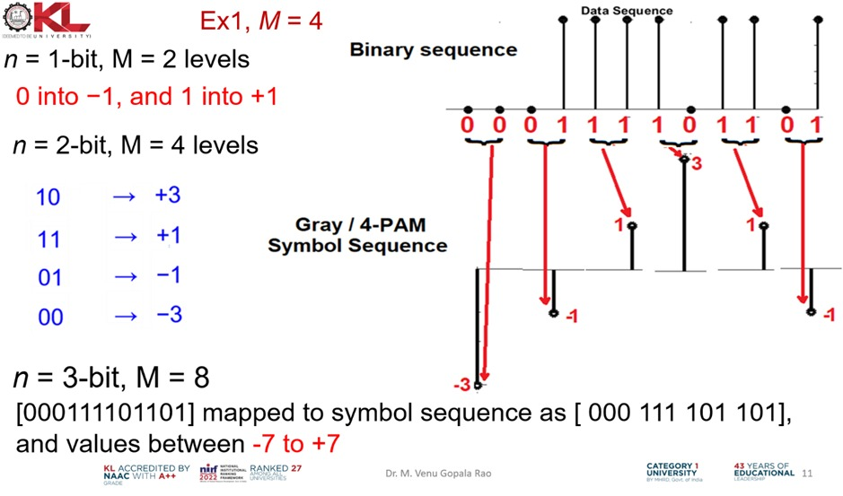

Slide 13
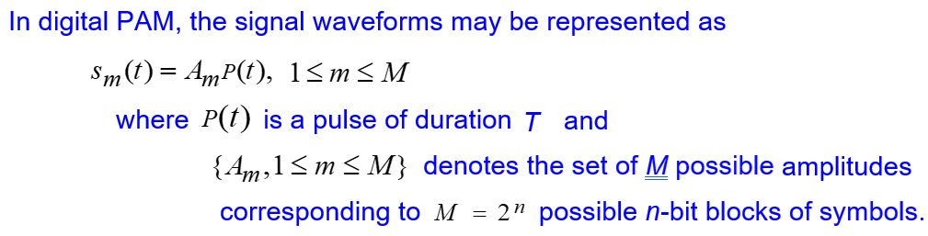
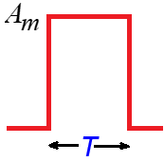
Symbols to Signals:
Even though the binary sequence is translated into the desired symbol-set or alphabet, it is not yet ready for transmission: it must be converted into an analog waveform or signaling waveform using an ideal digital to analog converter (zero order hold)

Slide 14
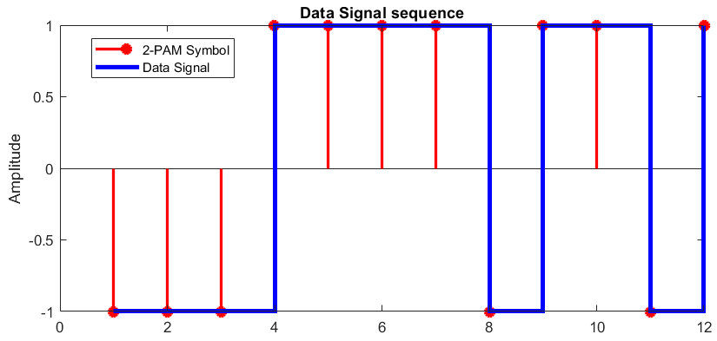
An example of Symbols to Pulse signals by rectangular pulse shaping M = 2 is shown below. Ideal DAC (zero-order hold)

Slide 15
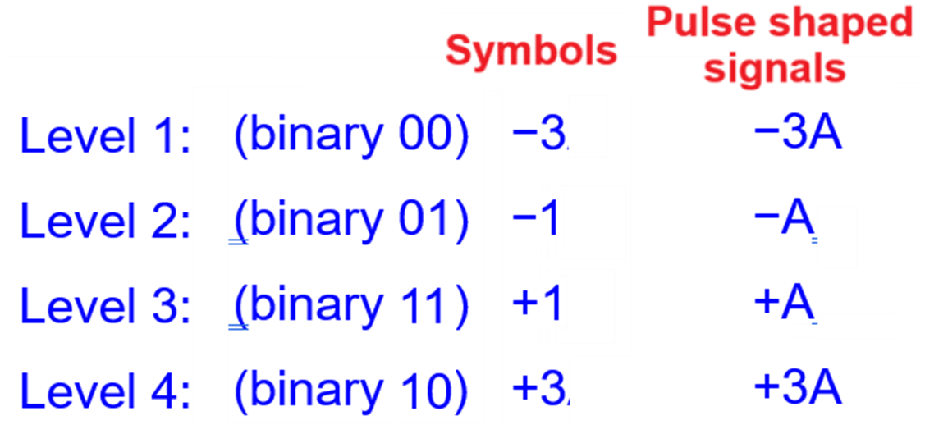

Slide 16
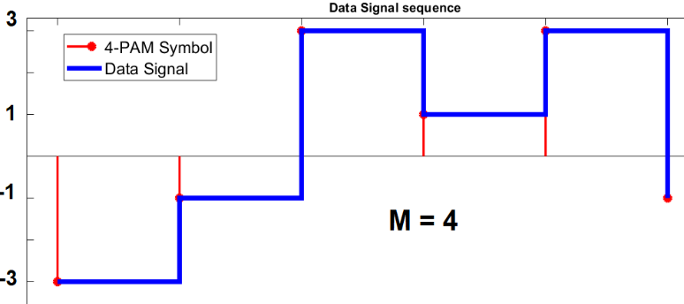
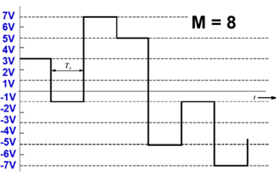

Slide 17
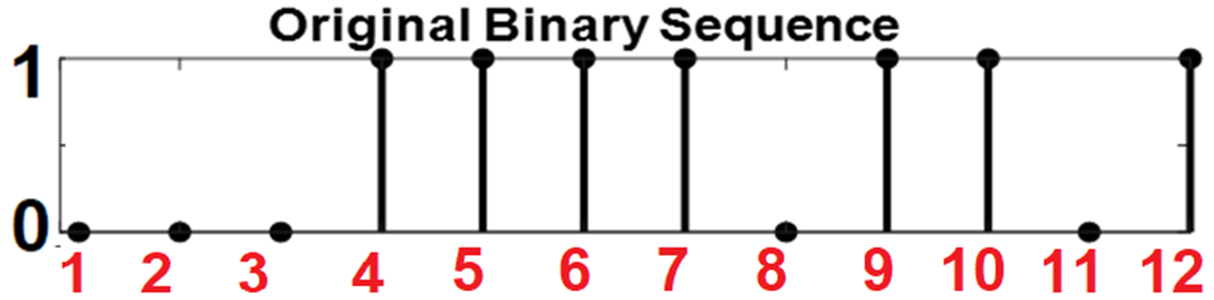
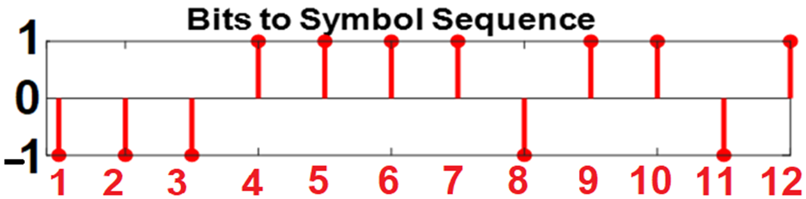
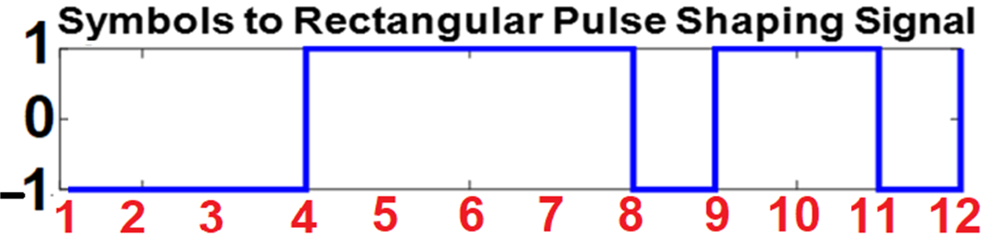

Slide 18
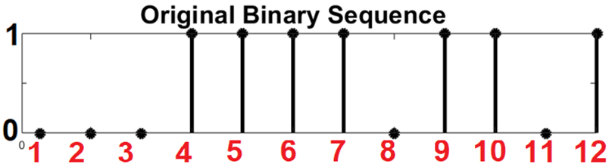
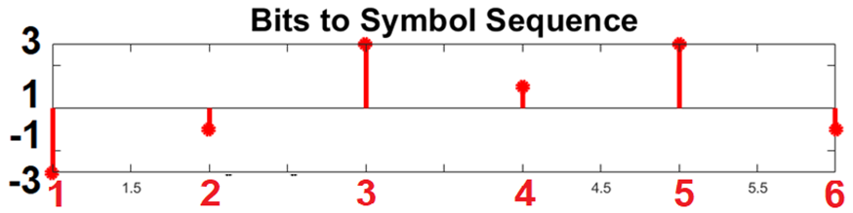
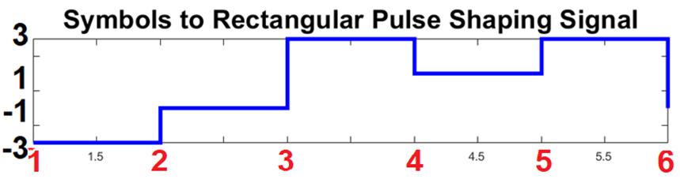

Slide 19
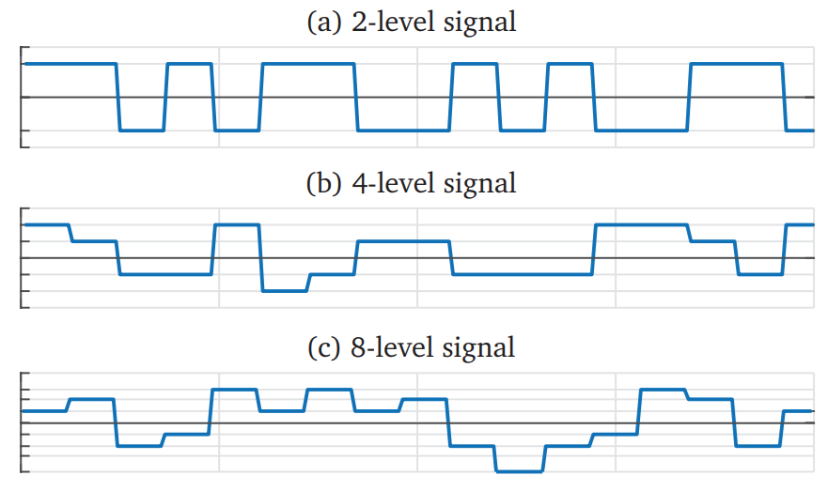

Slide 20
Channel Modelling

